Slide 1
BRFSS codebook
The Behavioral Risk Factor Surveillance System

Slide 2
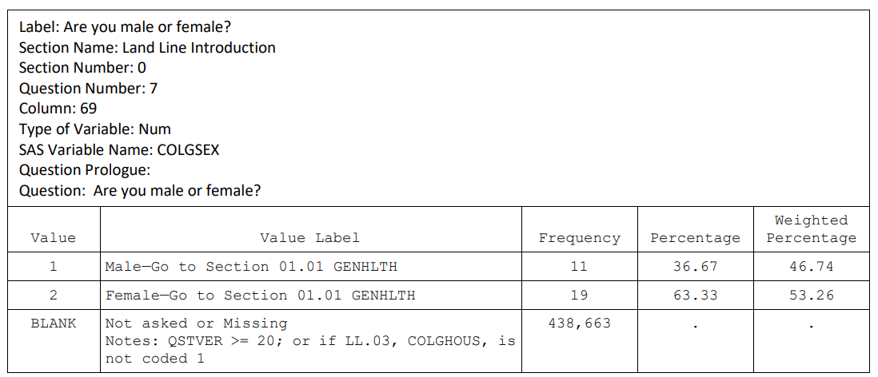
SEXVAR

Slide 3
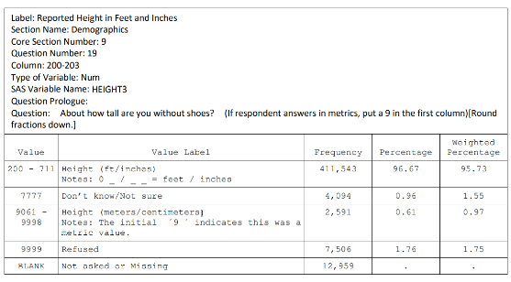
HEIGHT3

Slide 4
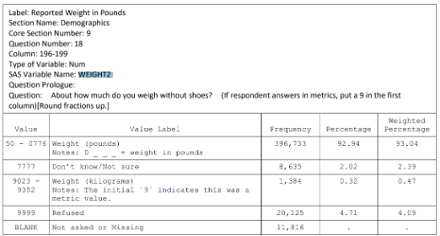
WEIGHT2

Slide 5
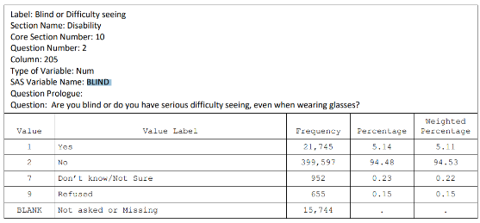
BLIND

Slide 6
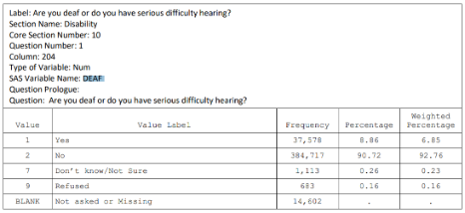
DEAF

Slide 7
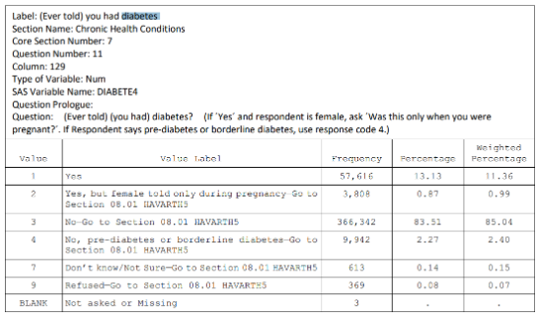
DIABETE4

Slide 8
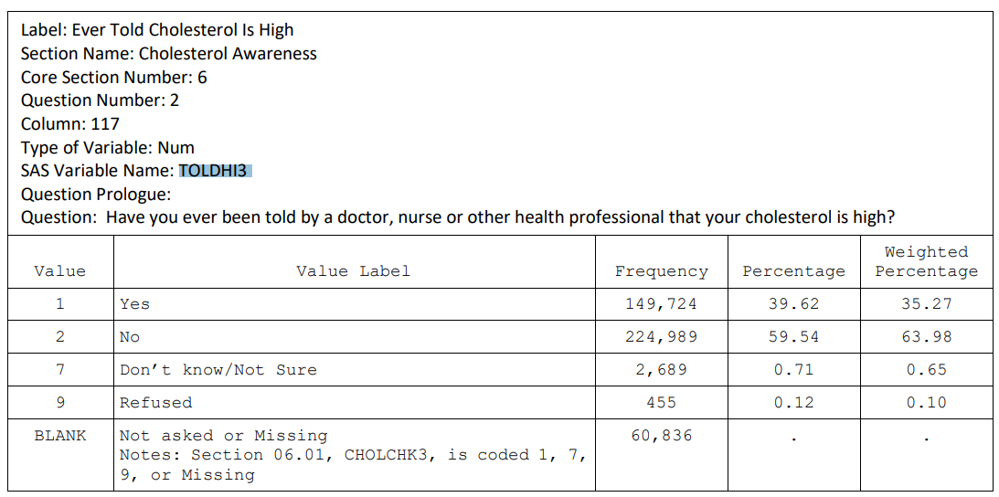
TOLDHI3

Slide 9
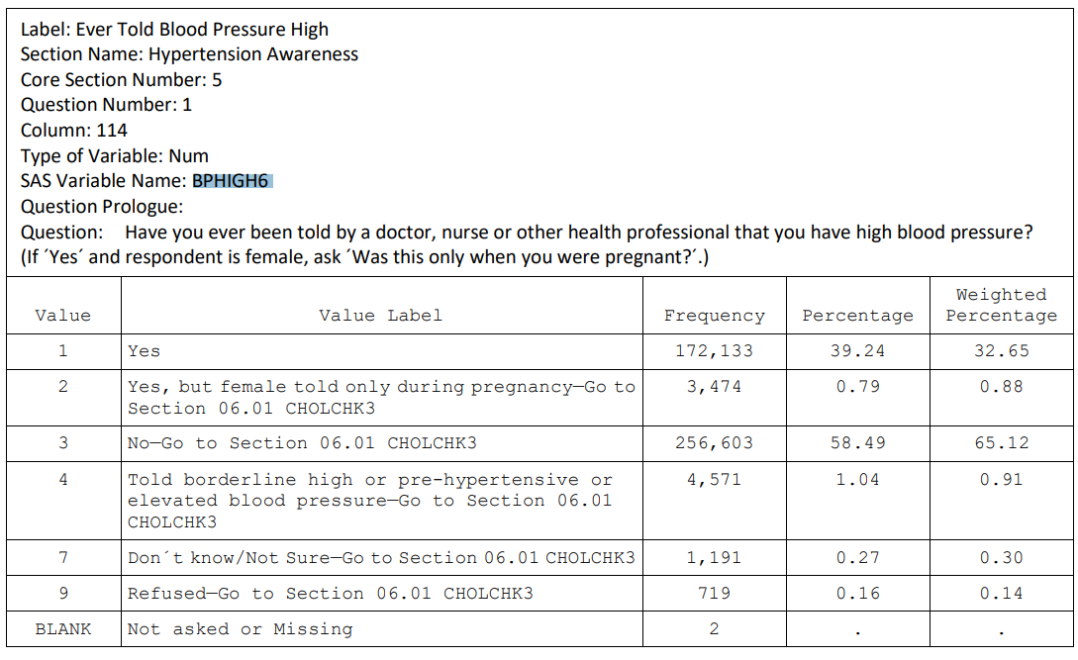
BPHIGH6

Slide 10
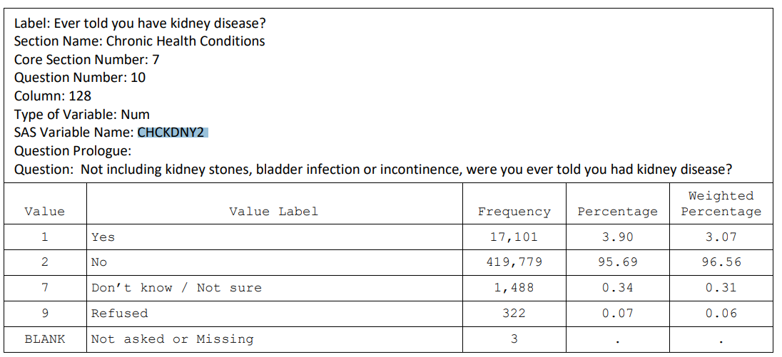
CHCKDNY2

Slide 11
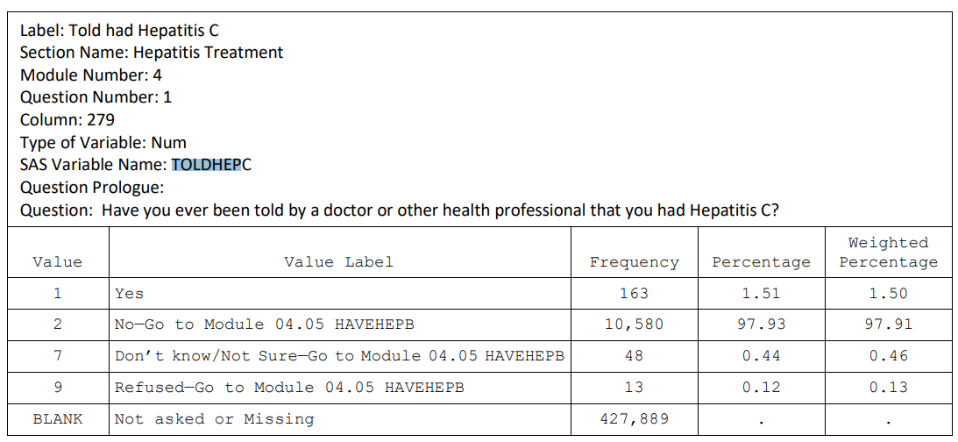
TOLDHEPC

Slide 12
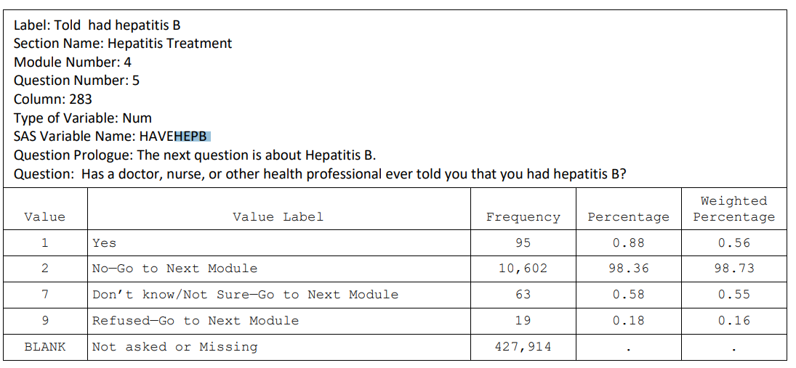
HAVEHEPB

Slide 13
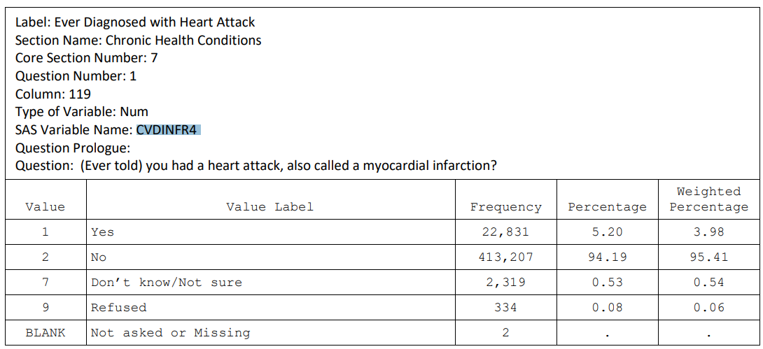
CVDINFR4

Slide 14
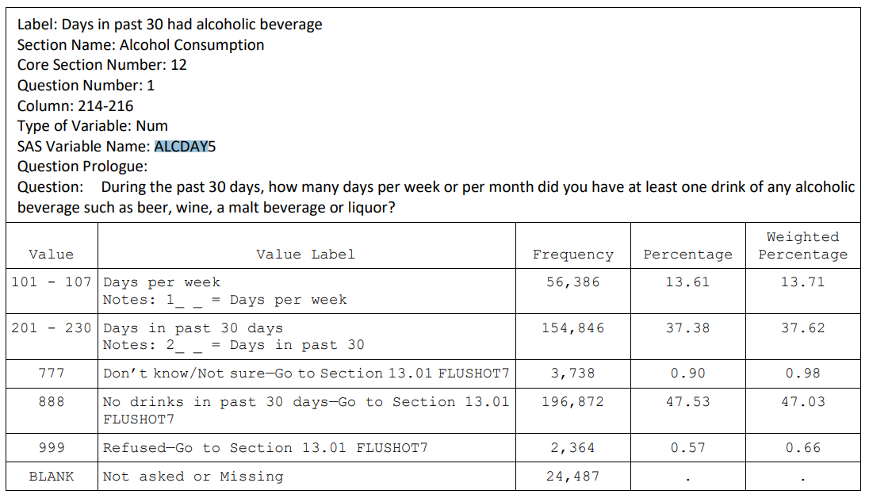
ALCDAY5

Slide 15
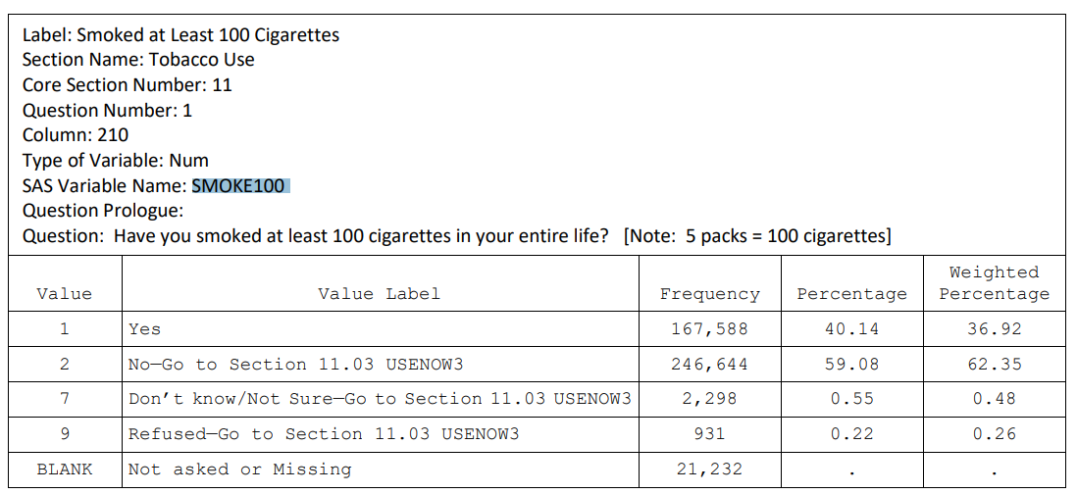
SMOKE100

